Slide 1

BCA FINAL YEAR PROJECT · 2025–2026
AI-Driven Classroom Engagement Monitoring Using Computer Vision
Presented By: Mahammadsadiq R Mujavar
Guide: Prof. Nafeesa Mulla
Bachelor of Computer Applications (BCA)
Nehru BBA and BCA College

Slide 2









Presentation Agenda
Introduction
Project Objectives
Technologies Used
System Architecture
System Modules
System Output
Advantages and Disadvantages
Future Enhancements

Slide 3
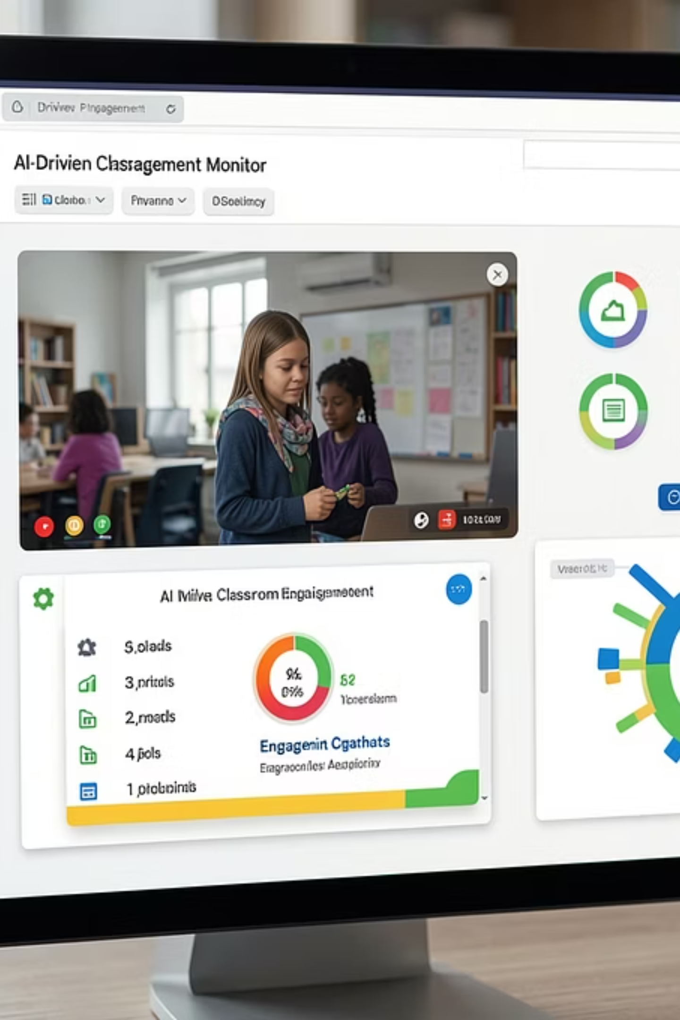
Introduction
Traditional classroom monitoring relies on manual observation — a method that is time-consuming, inconsistent, and unable to scale across large student groups. Teachers struggle to track attention levels across an entire classroom simultaneously, often missing subtle cues of disengagement.
This project proposes an AI-powered solution that leverages Computer Vision and facial landmark detection to automate engagement monitoring. The system processes live or recorded classroom video, identifies student behavior patterns, and generates real-time analytics and visual reports — empowering educators with actionable insights.
Problem
Solution
Output
Manual monitoring is slow and error-prone
AI + Computer Vision for automated analysis
Real-time engagement reports and heatmaps

Slide 4






Project Objectives
The system is designed with five core objectives that collectively transform passive observation into intelligent, data-driven classroom management.
Real-Time Monitoring
Behavior Detection
Pattern Analysis
Continuously track student engagement levels during live classroom sessions using webcam or video input.
Automatically classify students as attentive, distracted, or sleepy using facial landmark and head-pose analysis.
Identify recurring behavioral patterns across sessions to help teachers understand long-term engagement trends.
Reports & Heatmaps
Teaching Effectiveness
Generate visual engagement reports and classroom heatmaps that highlight distraction zones automatically.
Provide educators with AI-driven insights to adapt teaching strategies and improve overall classroom outcomes.

Slide 5
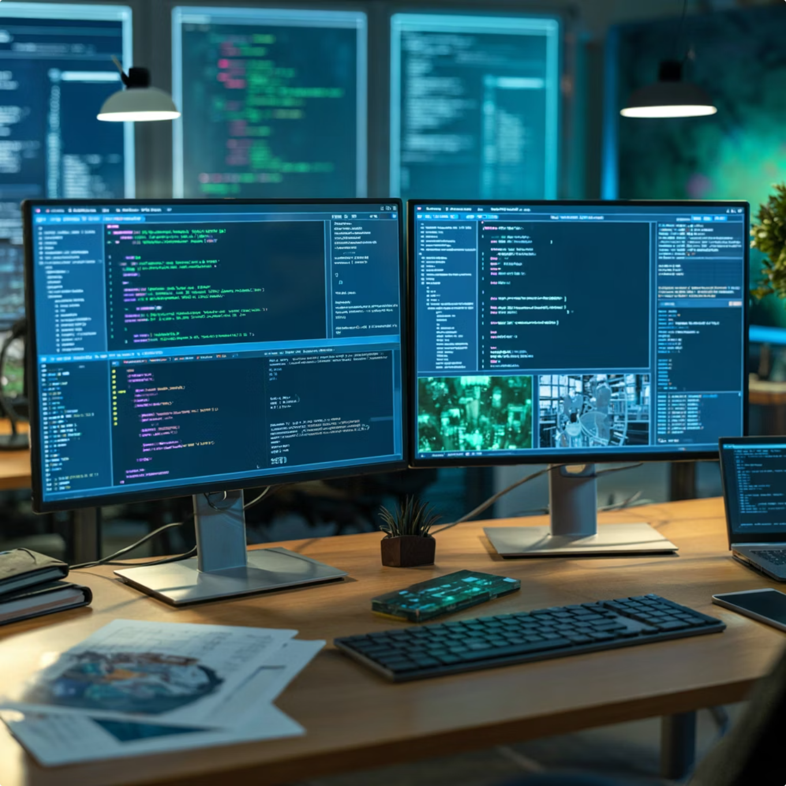

Technologies Used
The project is built on a modern, open-source technology stack selected for reliability, performance, and strong community support in AI and computer vision applications.
Technology
Role
Python
Core programming language
Django
Web framework & backend
OpenCV
Video & image processing
MediaPipe FaceMesh
Facial landmark detection
SQLite
Database management
VS Code
Development environment
HTML / CSS / JS
Frontend development
Chart.js
Analytics visualization
Core Pipeline: Python and Django handle backend processing and API logic. OpenCV processes classroom video frames in real time. MediaPipe FaceMesh detects 468 facial landmarks for precise engagement analysis. Chart.js renders interactive analytics on the frontend.

Slide 6
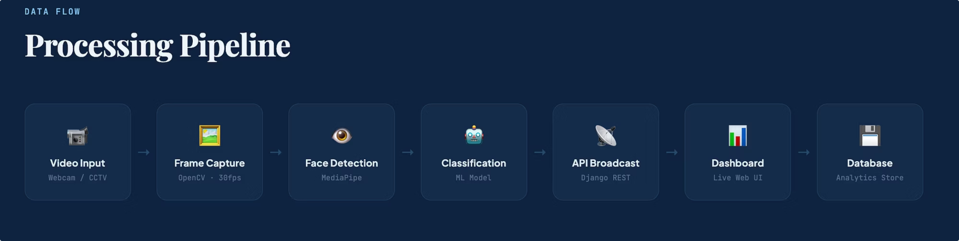
System Architecture
This is the actual system pipeline architecture, showing how classroom video moves from input capture through AI processing, classification, API broadcast, and storage before reaching the dashboard.
Video Input → Frame Capture → Face Detection → Classification → API Broadcast → Dashboard → Database

Slide 7
System Modules
The application is organized into six distinct modules, each responsible for a specific function within the engagement monitoring workflow.
User Authentication
Video Upload
Real-Time Monitoring
Secure login and registration system with role-based access for teachers and administrators.
Upload pre-recorded classroom session videos for offline analysis and report generation.
Live engagement detection via webcam feed with instant behavioral classification.
Analytics Dashboard
Heatmap Generation
Reports Management
Interactive charts, KPIs, and behavior statistics displayed in a unified dashboard view.
Visual overlay identifying classroom distraction zones and high-engagement areas.
Store, view, and export detailed session-level engagement reports in structured formats.

Slide 8
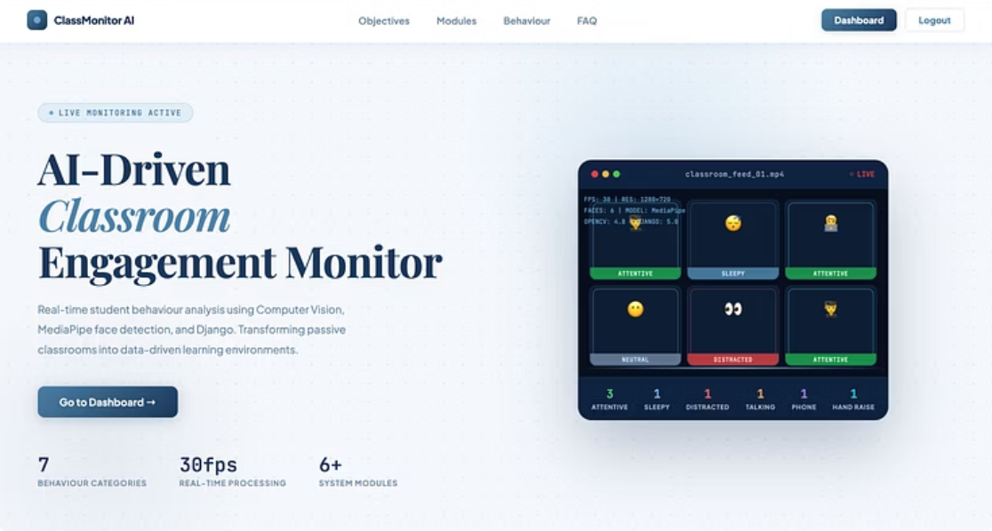
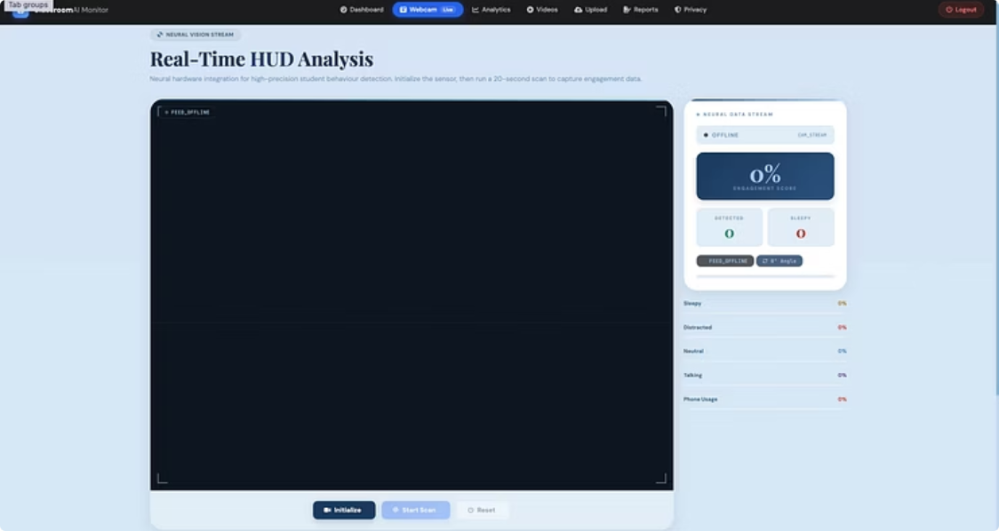
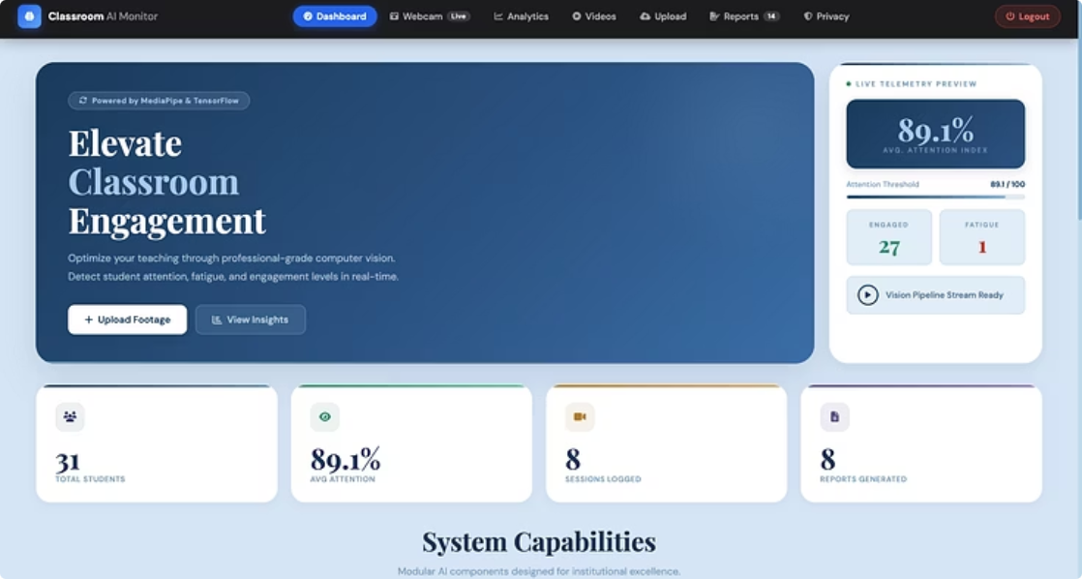
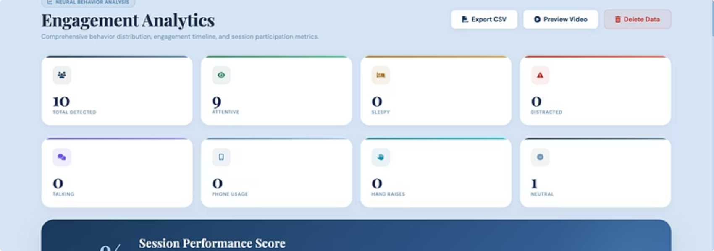
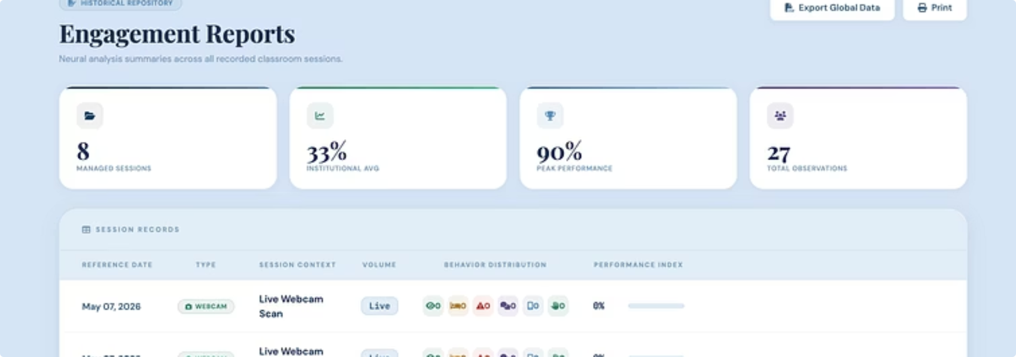
Software Snapshots
Explore the comprehensive user interface and powerful features of the AI-Driven Classroom Engagement Monitor application through these key software snapshots.

Slide 9
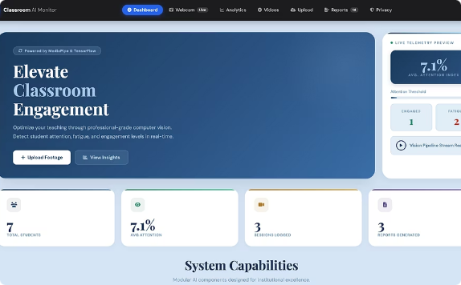
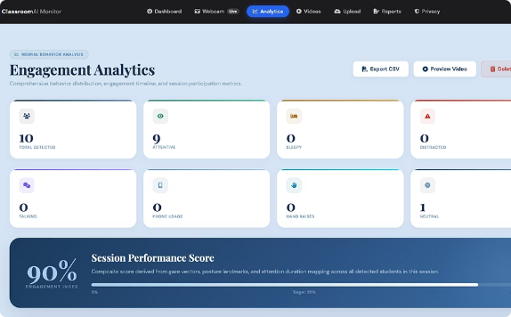
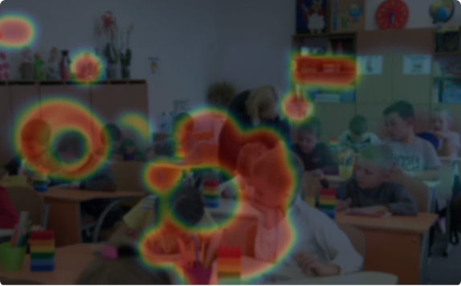
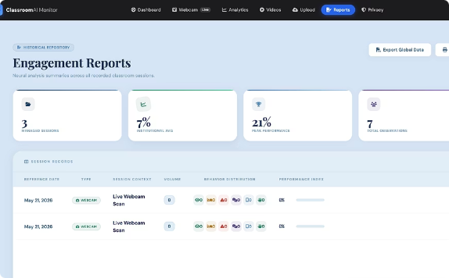
System Output
The application interface presents engagement data through four primary views, each designed for clarity and actionable insight.
Dashboard Page
Analytics Page
Heatmap Visualization
Reports Page
Central hub displaying real-time engagement percentages, student count, and session summary statistics at a glance.
Deep-dive visualizations including trend graphs, comparative charts, and per-student behavior breakdowns.
Color-coded spatial map highlighting distraction zones (red) and high-engagement zones (green) across the classroom layout.
Structured session reports with exportable data tables, engagement scores, and timestamped behavioral classifications.

Slide 10







Advantages and Disadvantages
Evaluating the dual impact of AI-driven classroom engagement monitoring reveals both significant benefits and important considerations.
ADVANTAGES
DISADVANTAGES
Real-time engagement monitoring
Objective and consistent data collection
Privacy concerns for students and teachers
Initial setup and hardware costs
Scalability across multiple classrooms
Reduced teacher workload for observation
Technical infrastructure and maintenance needs
Potential biases in facial recognition algorithms
Actionable insights for teaching improvement
Automated reporting and analytics
Requires training for educators on system use
Data security and storage considerations
Improved overall teaching effectiveness
Limitations in detecting complex emotional states

Slide 11
Future Enhancement
The current system establishes a strong foundation. The following enhancements are planned to evolve this into a full-scale smart classroom intelligence platform.
1
Cloud Deployment
Migrate to a cloud-native architecture (AWS/GCP) for scalable, multi-institution access and centralized data management.
2
Mobile Application
Develop iOS and Android apps enabling teachers to monitor engagement remotely and receive real-time alerts.
Emotion Recognition
3
Integrate deep learning models (e.g., FER, AffectNet) to detect emotional states — confusion, boredom, excitement — alongside engagement.
Multi-Classroom Monitoring
4
Support simultaneous monitoring of multiple classrooms with a unified admin dashboard for institutional oversight.
AI Recommendations
5
Build a recommendation engine that suggests teaching interventions based on detected behavioral patterns and historical trends.

Slide 12




Conclusion
This project demonstrates that Artificial Intelligence and Computer Vision can meaningfully transform classroom monitoring — moving from subjective, manual observation to objective, data-driven engagement intelligence.
The system successfully automates classroom engagement monitoring with real-time video processing and facial landmark detection.
AI and Computer Vision significantly improve monitoring accuracy and efficiency over traditional manual methods.
Real-time analytics empower teachers to understand and respond to student behavior more effectively.
The project directly supports smart classroom initiatives and modern education technology ecosystems.
Thank You
Presented By: Mahammadsadiq R Mujavar · BCA Final Year Project · Academic Year 2025–2026

